Slide 1
EMERIST
Emergency Assistant
by Arielle Mizrahi and Elena Golubeva
209381292 336377064
GitHub: https://github.com/ArielleMizrahi/EMERIST
Statecharts: https://youtu.be/iwVGALJUgvs
LSC: https://youtu.be/UKPiIeLD-pc

Slide 2
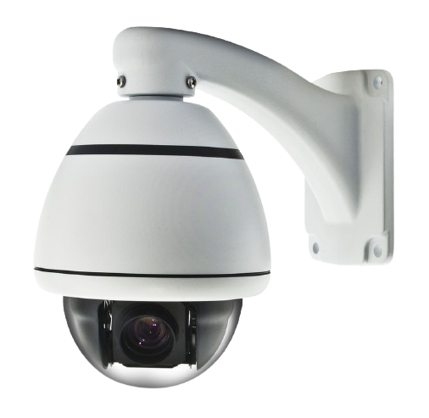
WHY?
We are living in a world of AI assistants. They provide a lot of services such as meeting reminder, recipe finder, information provider, alarm etc.
Generation Z gets used to these services fast and uses them more and more in daily lives.
We would like to present EMERIST, personal home assistant that will take care of you in your hardest times.

Slide 3
What is EMERIST?
Emerist - emergency assistant application that uses cameras around the house to track people’s behavior at all time. Only in emergency situations the application will save the recording, and upload to the cloud.
Authentication to Emerist application is done by face recognition system (we assume it is preinstalled).
Emerist application can control lights and security of the house.
Application is available via smartphones, tablet and computer.
*Uploaded data is secured and only available to people with access permissions

Slide 4

Input and Output
Inputs:
Data from security cameras that are installed around the house.
User’s pressings on systems buttons via application.
Outputs:
App push notification in case of emergency that contains:
Quick call to emergency operator
Link to live camera recordings
Future access to saved recordings of incidents

Slide 5
Reactivity of EMERIST:
EMERIST will receive data from video cameras that are preinstalled in one’s home.
In case of emergency relevant users will be informed via application notification. The app will display a live video from inside the house as well as let users to call relevant emergency facility (hospital, police, firefighters, etc).
User will also be able to control houselience via application (such as lights, security system, etc).

Slide 6
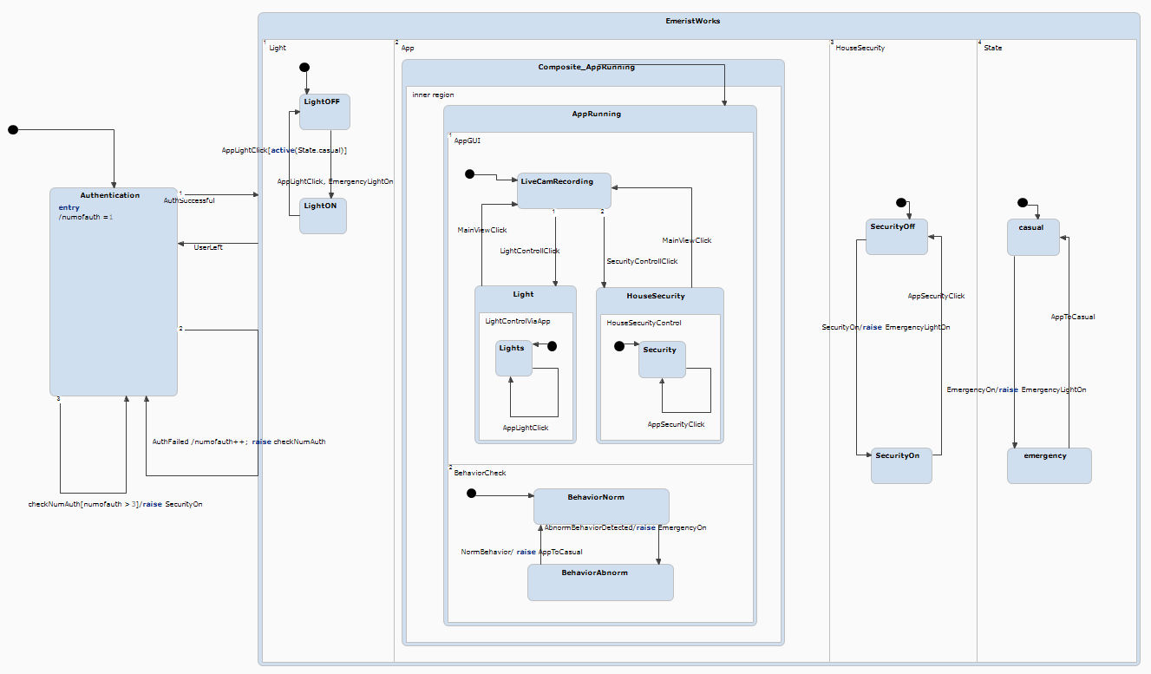
Emerist Statecharts Overview

Slide 7
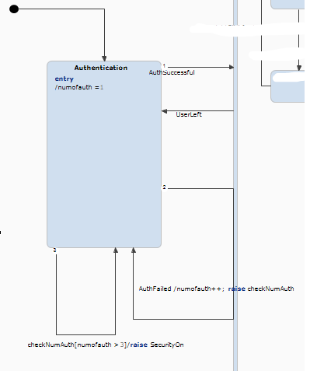
Statecharts - Authentication
We will let users authenticate themselves by face recognition.
User will have 3 tries to enter his details correctly - otherwise security will turn on.
Successful auth. Activates the system, if user leaves the house - system is in “sleep mode” (inactive).

Slide 8
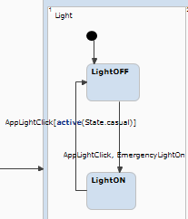
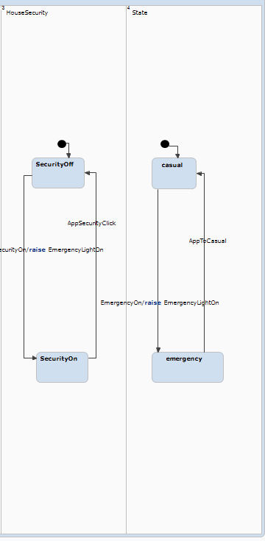
Statecharts - Lights, Security and States
Lights can be controlled by a user and the application.
Also we make sure that user cannot turn off the lights by clicking LightOFF via application.
Lights can be turned on also whenever the system is enters emergency state (e.g. authentication failed or abnormal behavior was detected).

Slide 9
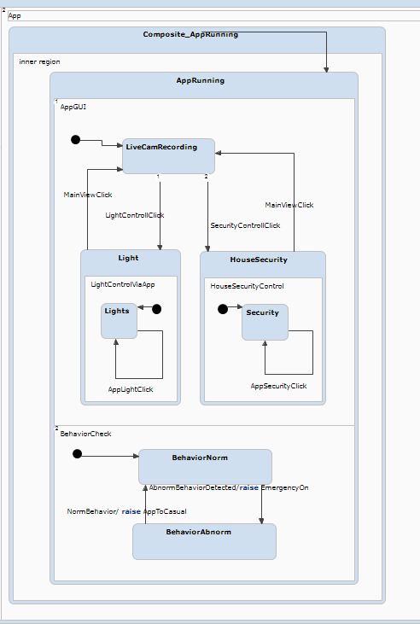
Statecharts- Application GUI
This is the Emerist app possibilities:
Checking behavior.
If behavior is abnormal then emergency state is raised.
User can control the lights, change system’s state to “casual”.

Slide 10
LSC - System Specifications
When a person approaches the house - system will require an authentication (face recognition)
If authentication is successful, application is in state “casual”, otherwise system is set to “emergency” state and users get a push notification.
When system is in “casual” state and person is at home, system tracks person’s behavior all the time.
When the system detects an abnormal behavior, the system starts recording, push notification is sent to users and the lights are ON.
When the system is changed by user from “emergency” to “casual” state - system stops recording and saves the file.
When user leaves the house, application turns OFF all the lights.

Slide 11
LSC - System Interface Specifications
When authentication failed or abnormal behavior detected, system state updates to “emergency”, system turns ON the lights.
When the system is in “emergency” state, user cannot turn OFF the lights until state is changed to “casual”.
When the user presses “Lights” button, the lights state changes from ON to OFF and vice versa.
When user presses “Call Emergency”, the system gives options to call Police, Firefighters or Ambulance.
When user presses “System to Casual” button, the system state updates to “casual”.

Slide 12
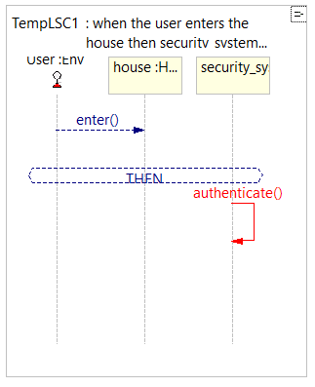
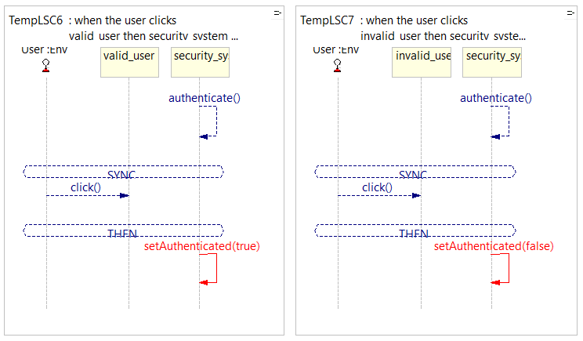
LSC - Authentication
“when the user clicks valid_user then security_system authenticated changes to true”
“when the user clicks invalid_user then security_system authenticated changes to false”
We make user press buttons for authentication (valid and invalid) to imitate face recognition by security system.
User’s choice affects system’s state.
authenticate() is a unification message between two LSC
“when the user enters the house then security_system authenticates”
LSC that upon every house entry authenticates user.

Slide 13
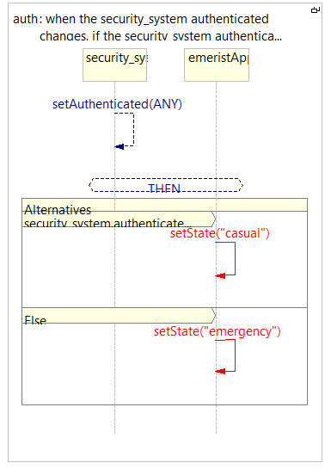
LSC - System’s state based on authentication
“when the security_system authenticated changes, if the security_system authenticated equals true , emeristApp state changes to casual, otherwise emeristApp state changes to emergency”
This LSC sets system’s state to emergency or casual based on authentication status.
If user was authenticated successfully (pressed “valid_user” button), then system will be in casual state.
If user pressed “invalid_user”, then system will be in emergency state.

Slide 14
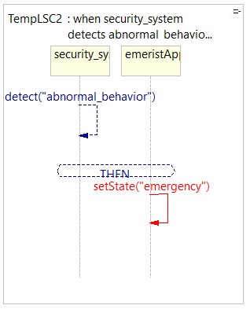
LSC - Emergency due to abnormal behavior
“when security_system detects abnormal_behavior then the emeristApp state changes to "emergency"”
System’s state is updated to “emergency” due to detected abnormal behavior.

Slide 15
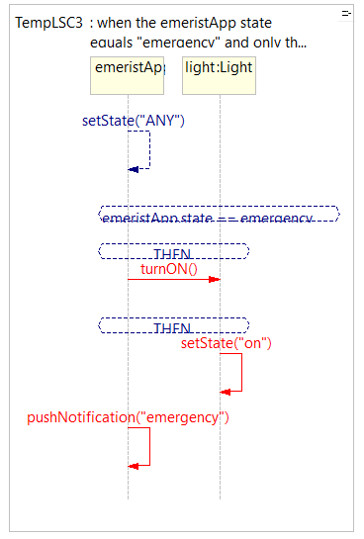
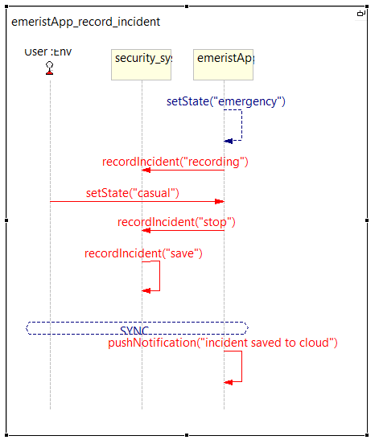
LSC - System’s reaction to emergency state
“when the emeristApp state equals "emergency" and only then the emeristApp turnON lights then the light state changes to on then the emeristApp pushNotification emergency”
When system is in emergency state it turns on all the lights, sends notification via application and starts recording of the incident.
Recording stops when the system is back to casual state (triggered by user), and notification is send.
setState() of emeristApp is a unification between these and two previous LSCs.

Slide 16
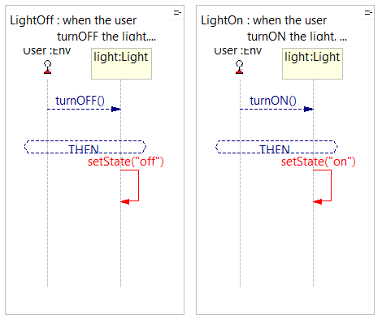
LSC - User’s light control via application
“when the user turnOFF the light, the light state changes to off”
“when the user turnON the light, the light state changes to on”
These LSC let user to control lights via emeristApp.
turnON() and turnOFF() are two unification messages between these and the following LSC.

Slide 17
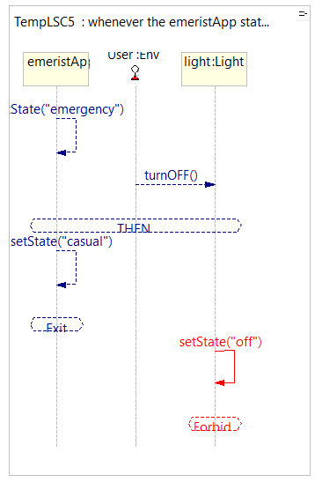
LSC - Forbidden scenario
“whenever the emeristApp state changes to emergency and the user turnOFF light then the light state must not change to off until the emeristApp state changes to casual”
We forbid forbid turning off lights during emergency.

Slide 18
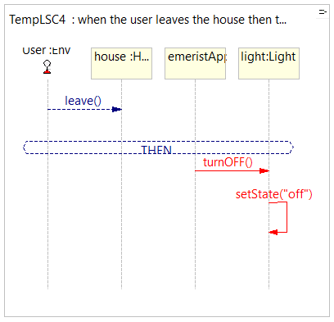
LSC - When user leaves
“when the user leaves the house then the emeristApp turnOFF light then the light state changes to off”
Application turns off the lights when user leaves the house.

Slide 19
Reflections - Elena
I had a lot of struggle to create complex LSC’s using natural language. I found our work around by creating smaller charts and using simple language. We also had some hard times building a statecharts with conditions (as there are not a lot of practical examples anywhere), but we were able to find our answers during class sessions.
I faced other struggles related to project management but I’ve learned a lot and feel more confident starting new projects and finish them without getting lost in the process.
I wish we did more practice in both softwares during the classes before we started working on project itself, because only in the end I understood how two of them are related and what should be covered in which environment.
As for me, I felt more confident and enjoyed more working with statecharts. When I worked with LSC sometimes I couldn’t understand when it’s my fault and when it’s just system’s bug which made the process harder.

Slide 20
Reflections - Arielle
I learned a lot from this course, I was able to really connect to the visual way of programming that we really mostly dealt with in the course. What intrigued me very much is how things happen especially because I have a smart home in my house and I wanted to understand below the surface how things are done and really also be able to perform and get the results we got.
First of all, in the online course at EDX I had a hard time understanding the high English and therefore the level of my comprehension was not high because of it. In addition to that I had a hard time dealing with the LCS in the part where we had to write in natural language because really PlayGo did not really know how to naturally translate for us to perform but over time we got along and glad we had challenges and we did not give up and kept trying and thanks to that we got an amazing project.
I really connected to the subject of our project and it was very important to me that we succeed in getting it done in the best way and Elena was the perfect partner.
In the practical aspect, we worked on the Statecharts and the LSC’S together it was important for as to keep trying to understand in depth how things work.
Thank you so much Michal for giving us the support and help we always needed, it's really not obvious and we really appreciate it.

Slide 21

THANK YOU HOPE YOU ENJOYED

